Slide 1
Capstone Project on ​"Travel App"​
By​
Sai Rishitha Mangipudi​
MGSA_513

Slide 2
CONTENTS:
1.Abstract
2.Introduction
3.Module-1
4.Module-2
5.Module-3
6.References

Slide 3
ABSTRACT​:
Salesforce provides customer relationship management (CRM) software and applications focused on sales, customer service, marketing automation, analytics, and application development.​
Salesforce's main technologies are tools for customer management. Other products enable customers to create apps, integrate data from other systems, visualize data, and offer training courses.​
​In here we work on how to Set up the Company Profile, Configuring the user Interface, setting up Activities and Calendars, Configuring Search Settings, Setting up Chatter Groups, Mobile Access with salesforce.​

Slide 4
INTRODUCTION:
A custom travel approval app has can be built so that Employees can submit an electronic request in the system for future travel. Each request can include a list of estimated expenses for airfare, hotel, rental car, and so on.
Each request could be approved by the employee’s manager, and all out-of-state travel could be approved by a travel coordinator.
Managers would need reports and dashboards to track key travel request trends and KPIs.
In addition, employees and managers could be able to access their travel requests, approvals, and dashboards via mobile device.

Slide 5
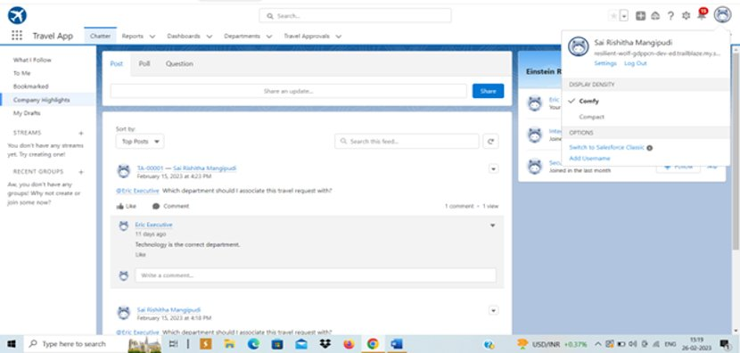
MODULE-1​:
This module is aimed at building a working prototype of the new travel approval application.​ This module deals with creation of Custom App, Objects, Fields & Relationships, and customization of the App using declarative tools.​
Exercise-1:​
Step-1​
Created a new Custom Lightning App named Travel App​
​

Slide 6
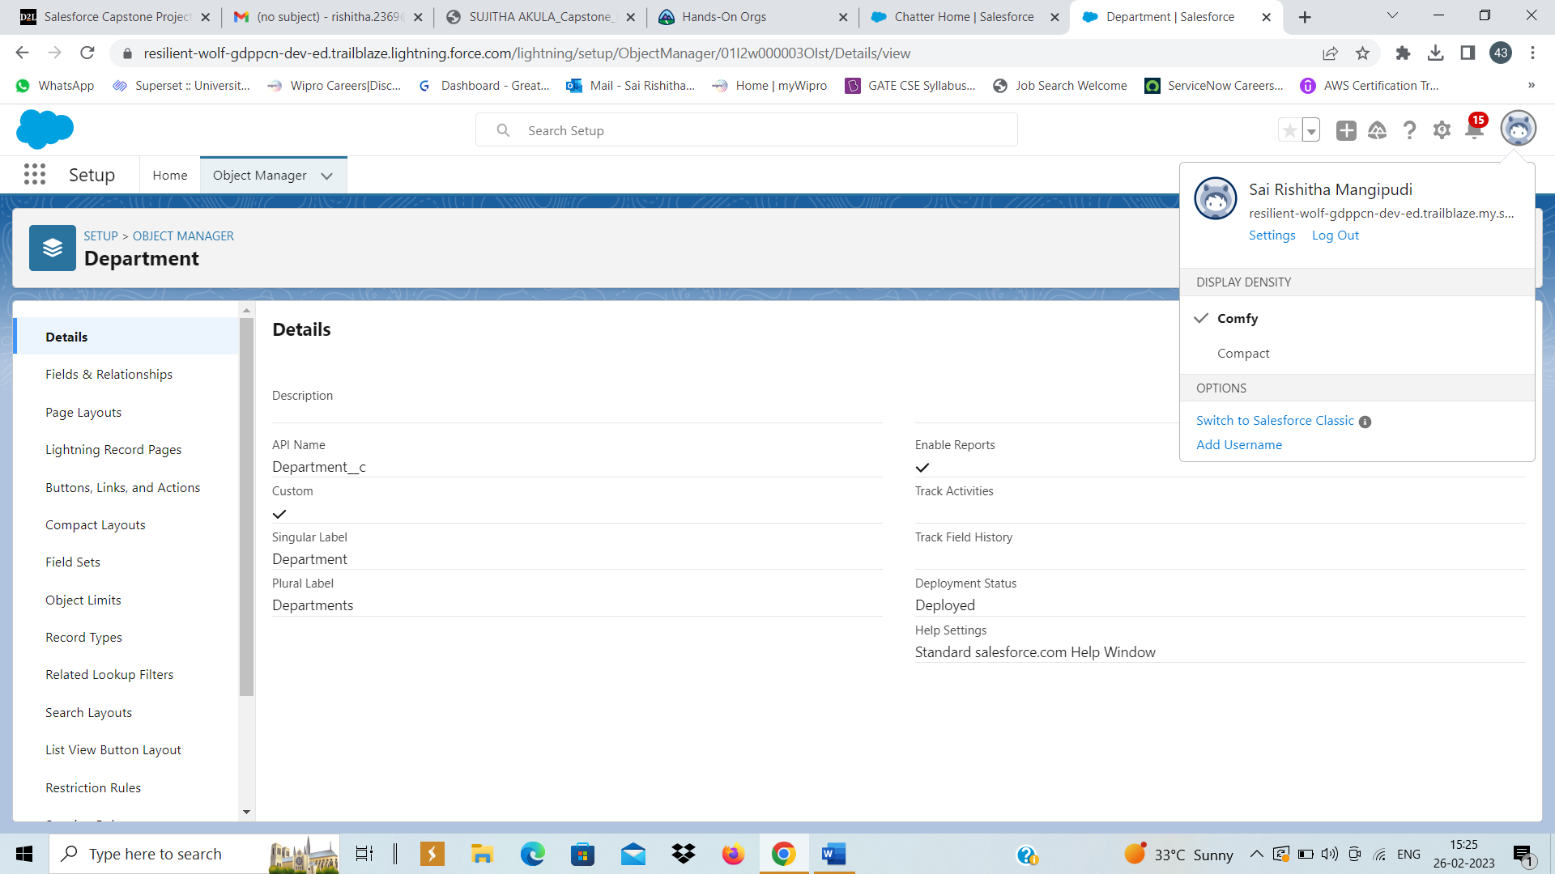
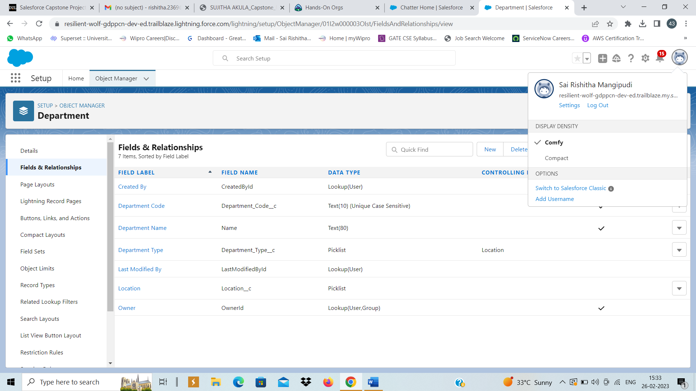
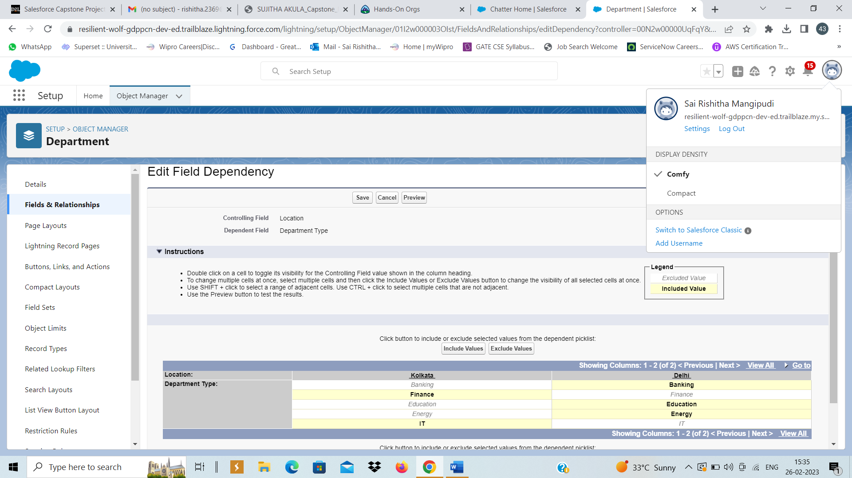
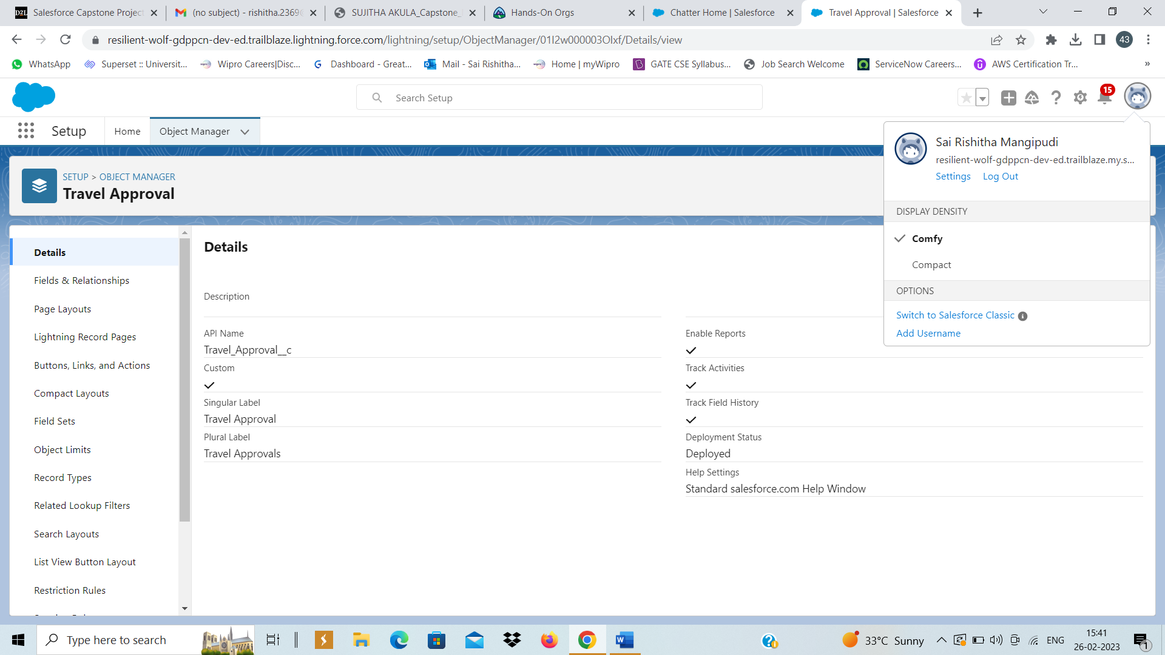
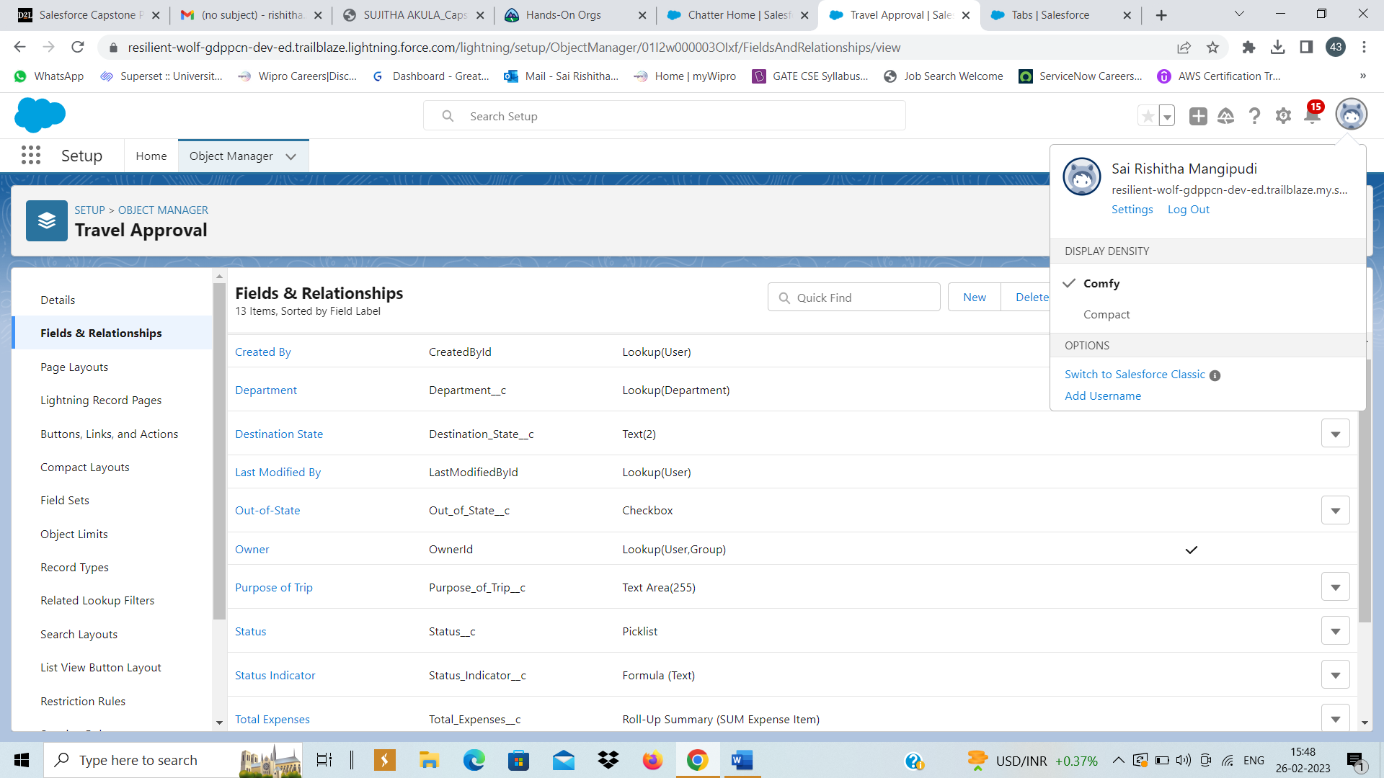
Steps 2-4 Created "Department" and "Travel Approval" custom objects with required custom fields and Tabs for respective Objects​.Required Field Dependencies were created.

Slide 7
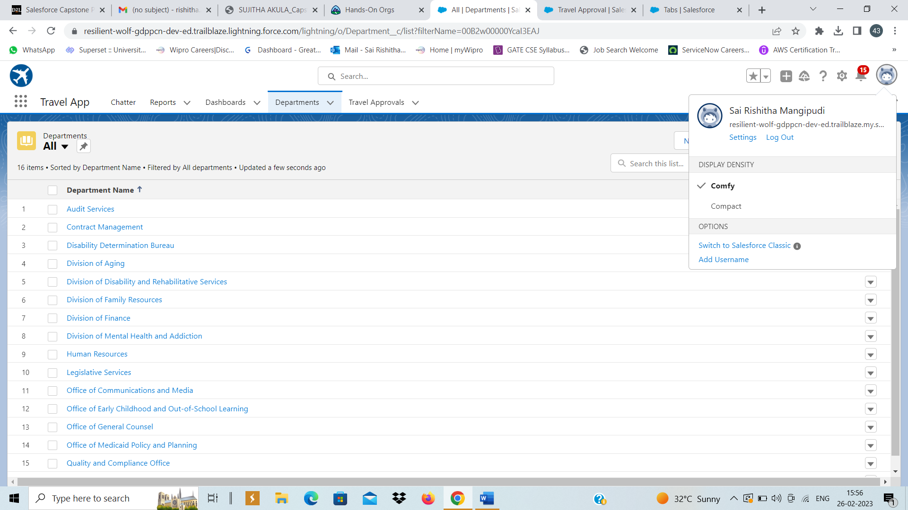
Step-5​ Imported Department records using Data Import Wizard​

Slide 8
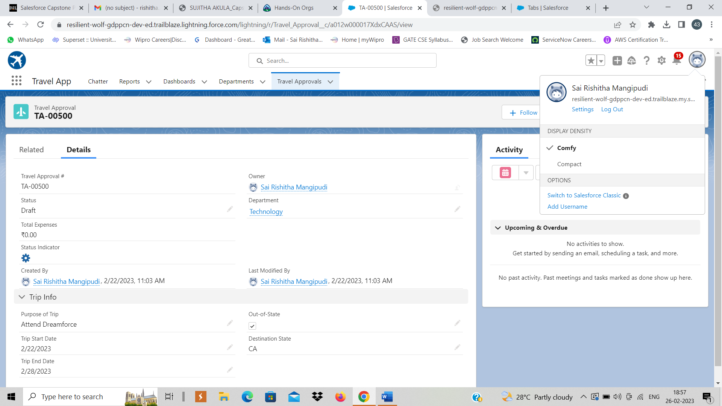
Exercise-2​ Step-1:​ Created a Travel Approval Record​

Slide 9
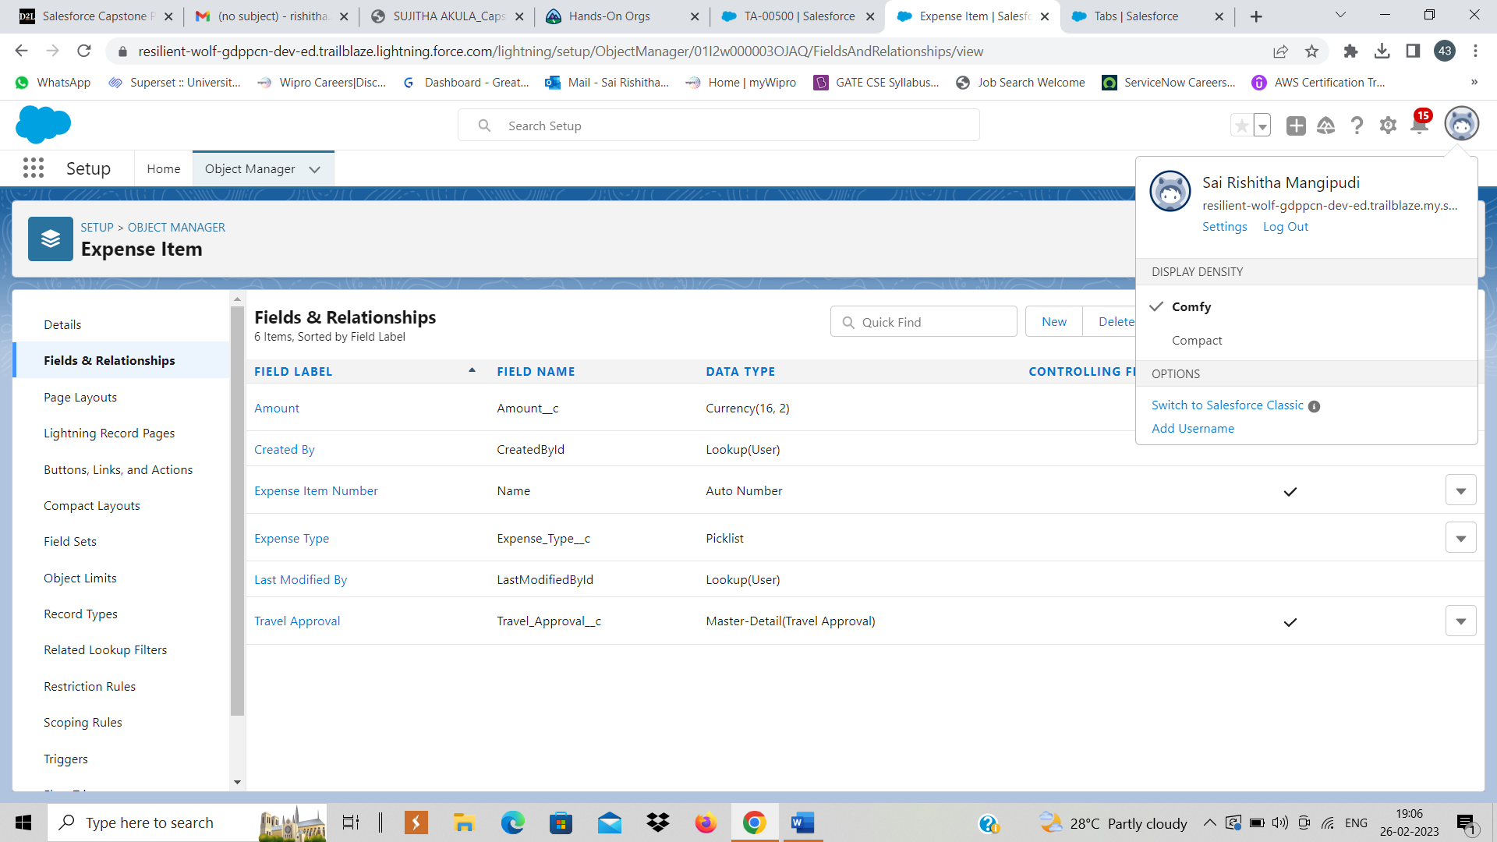
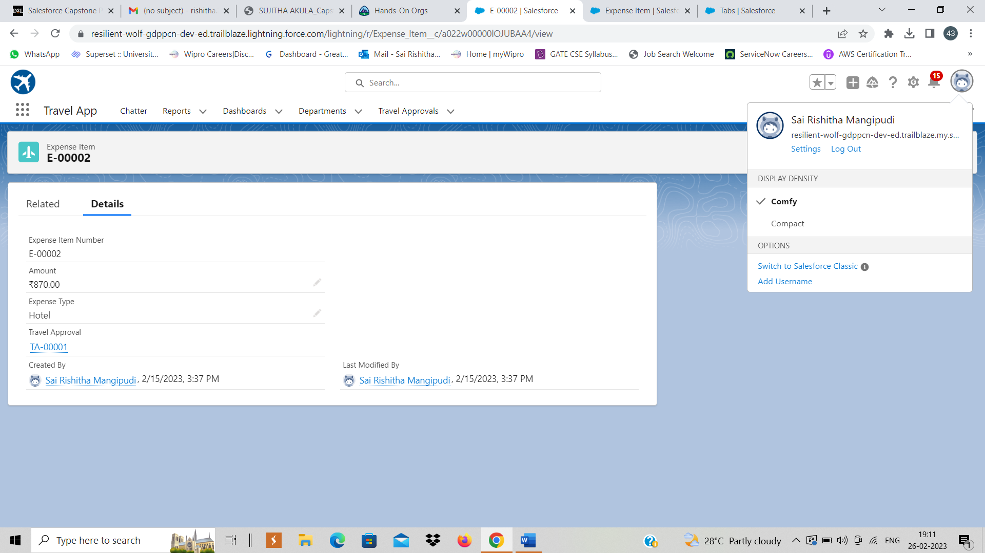

Steps 2-4​ Created "Expense Item" custom object with fields and also added two expense item records as specified​

Slide 10
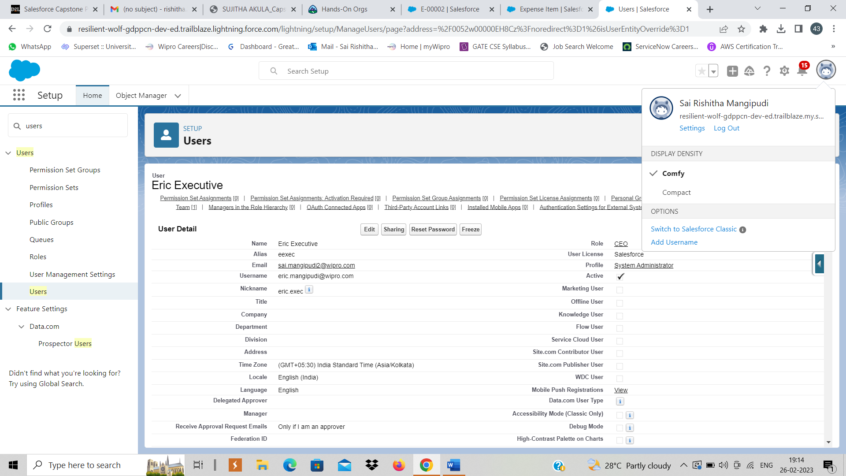
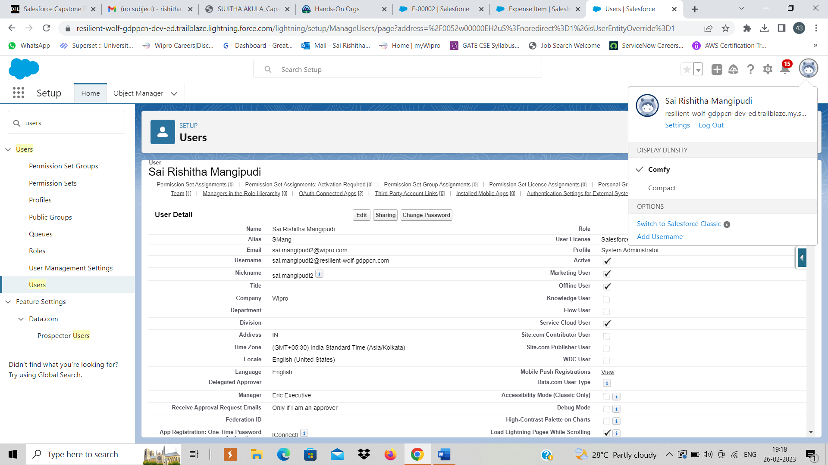
Steps 5-6​ Created a user Eric Executive and added him as the manager .

Slide 11
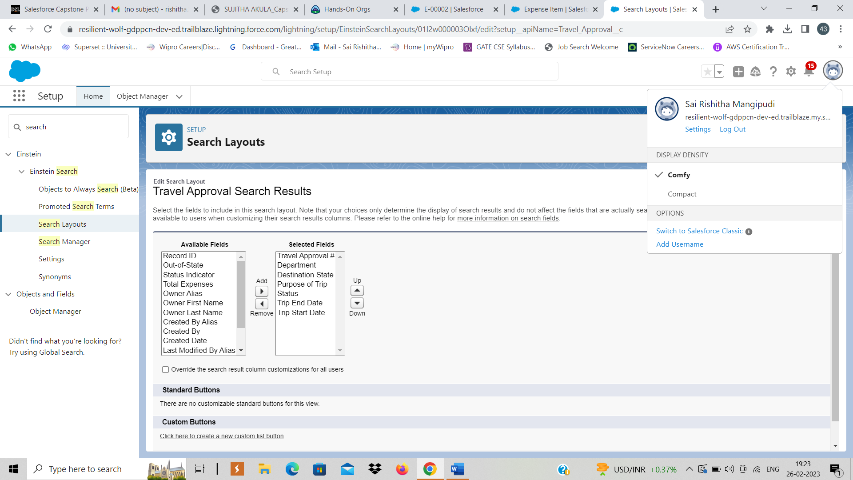
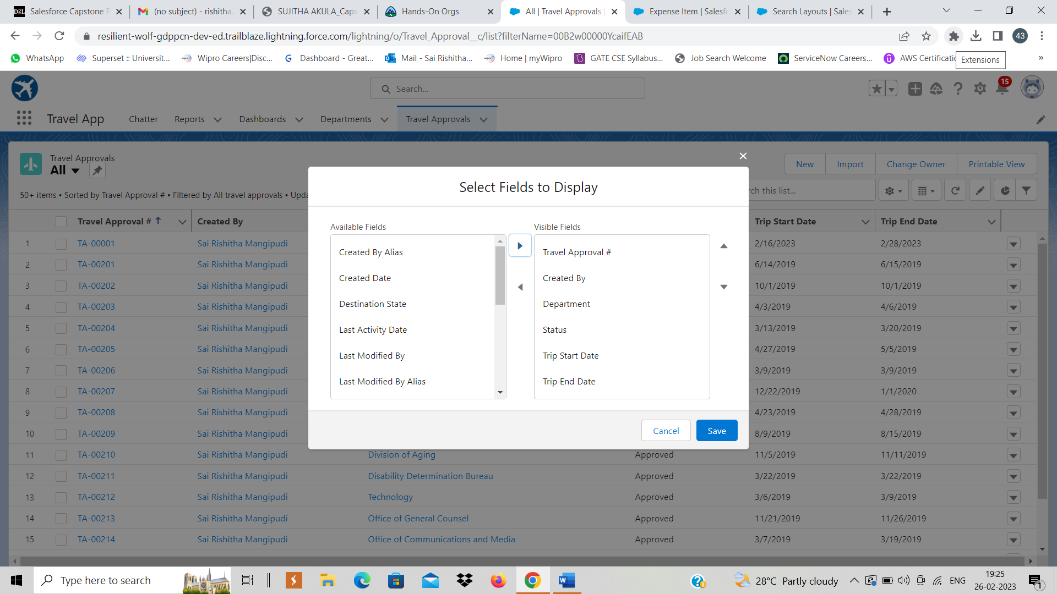
Steps 7-10​ Customized the Travel Approval Search Layout and worked on list Views

Slide 12
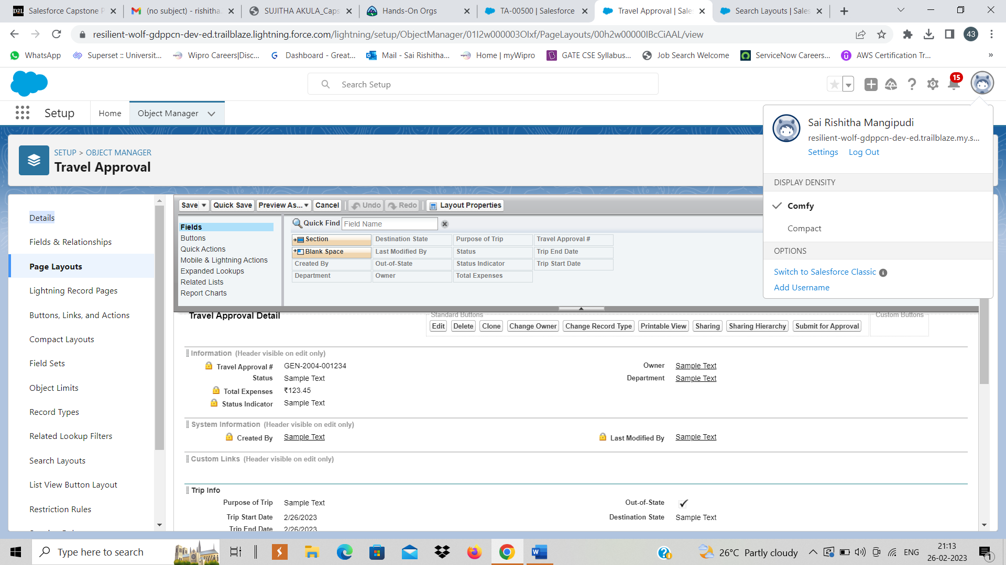
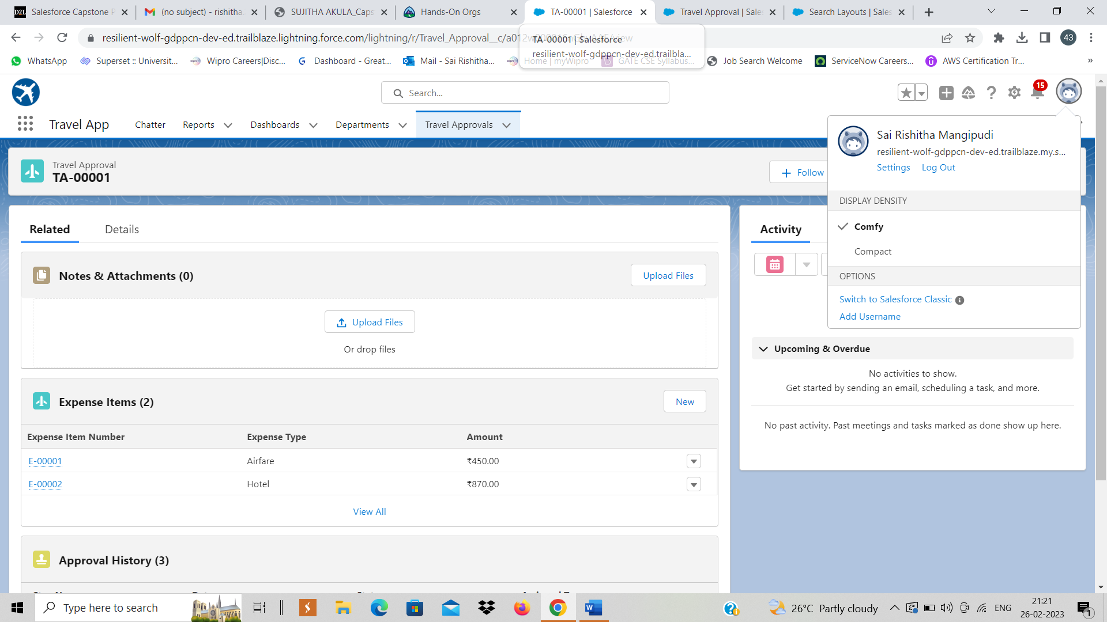
Step-11-12​ Customized the Travel Approval Page Layout and Expense Item Related List

Slide 13
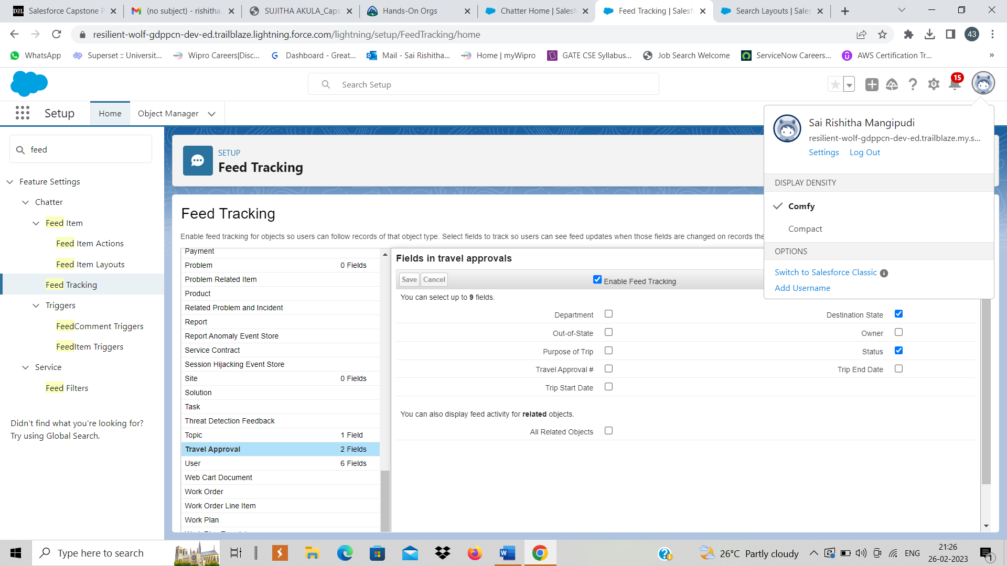
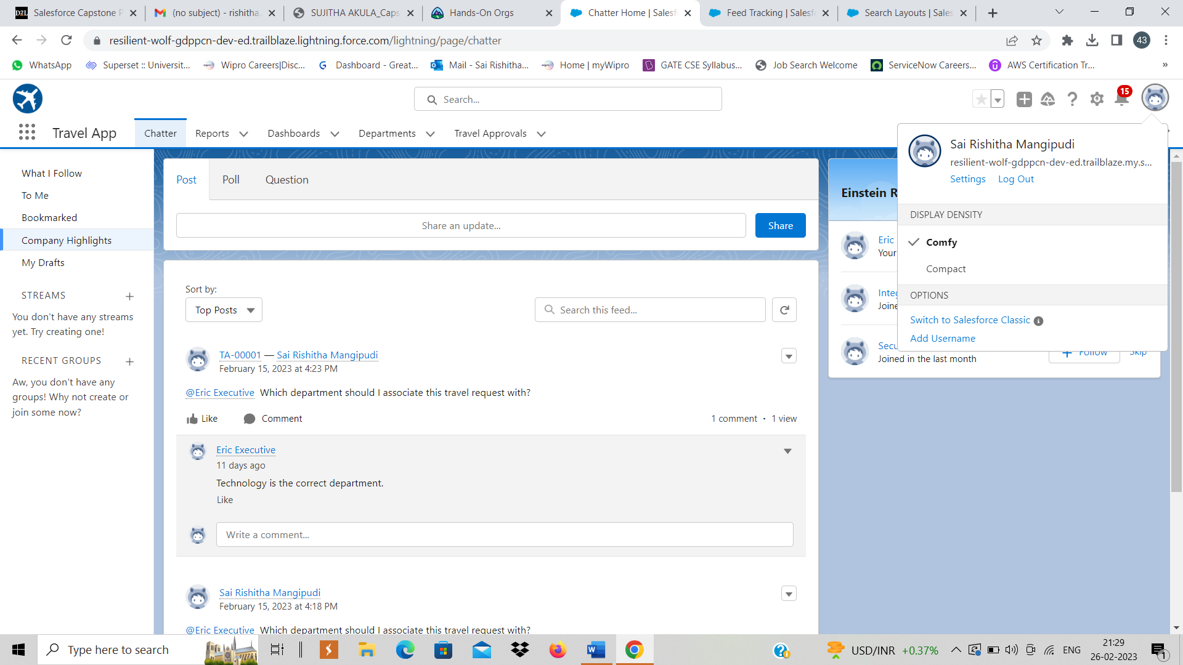
Step-13:​ Enabled Chatter, feed tracking on Travel Approval and tested Collaboration

Slide 14
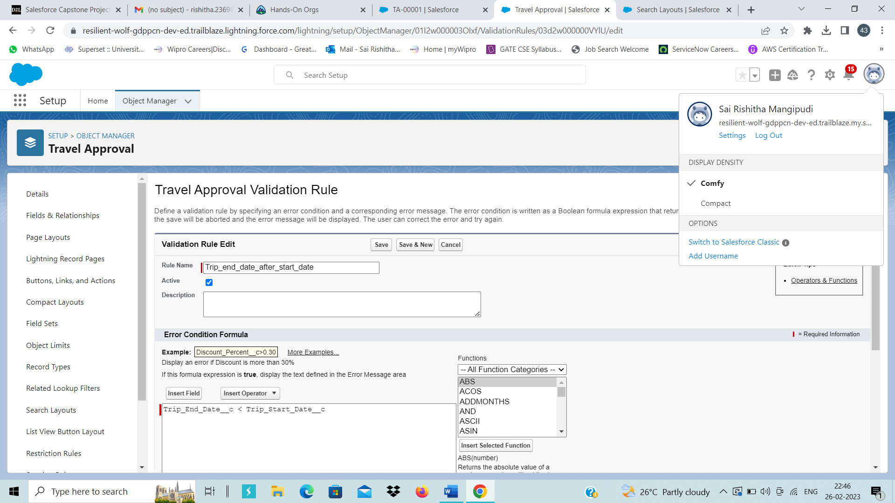
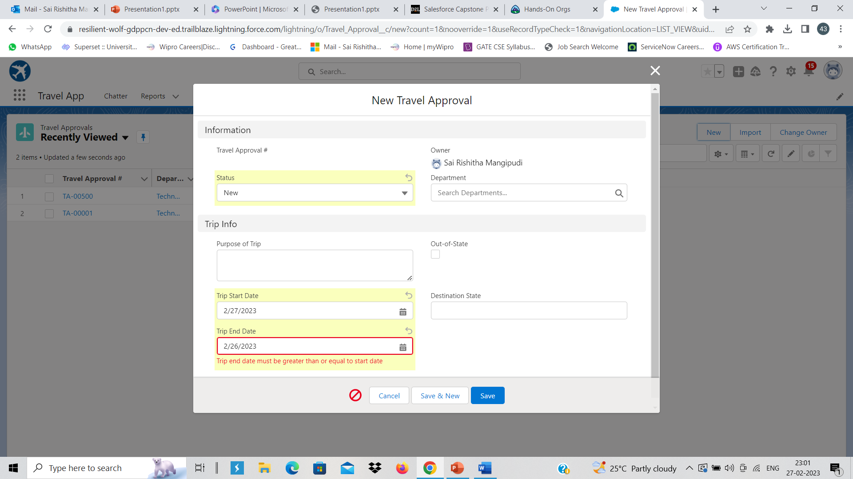
MODULE-2​:
In this module Business logics and analytics have been added to the Travel App to improve the user experience using Validation rules, Roll-up summary fields, Formulas, Flows & tracking of Travel Approvals using Reports and Dashboards.
Exercise-1​ Step-1​ Created a Validation Rule to check if Trip end Date is greater than Trip Start Date​

Slide 15
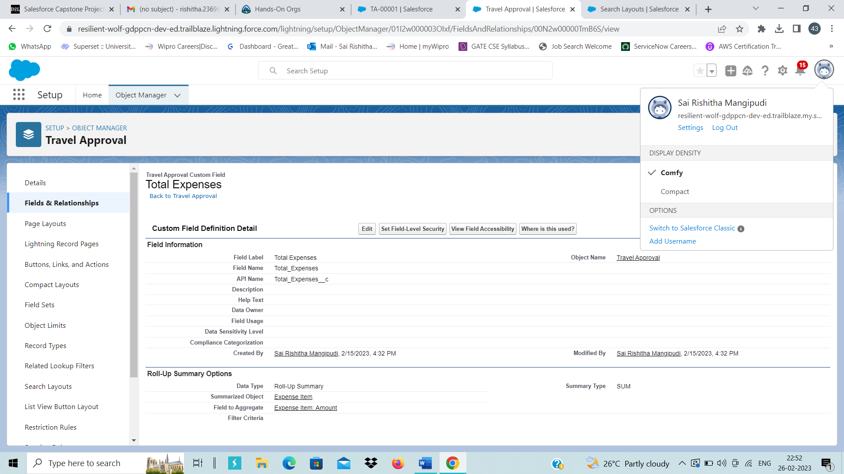
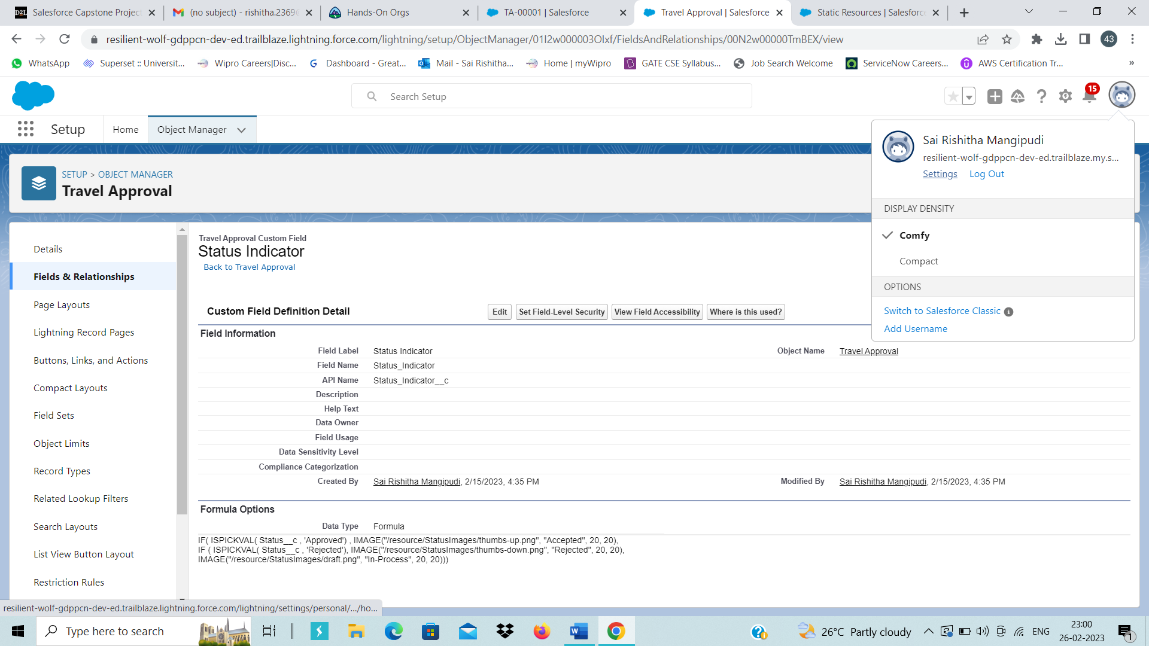
Steps 2-4​ Created a Roll-Up Summary field and formula field to show status on Travel Approval Object .

Slide 16
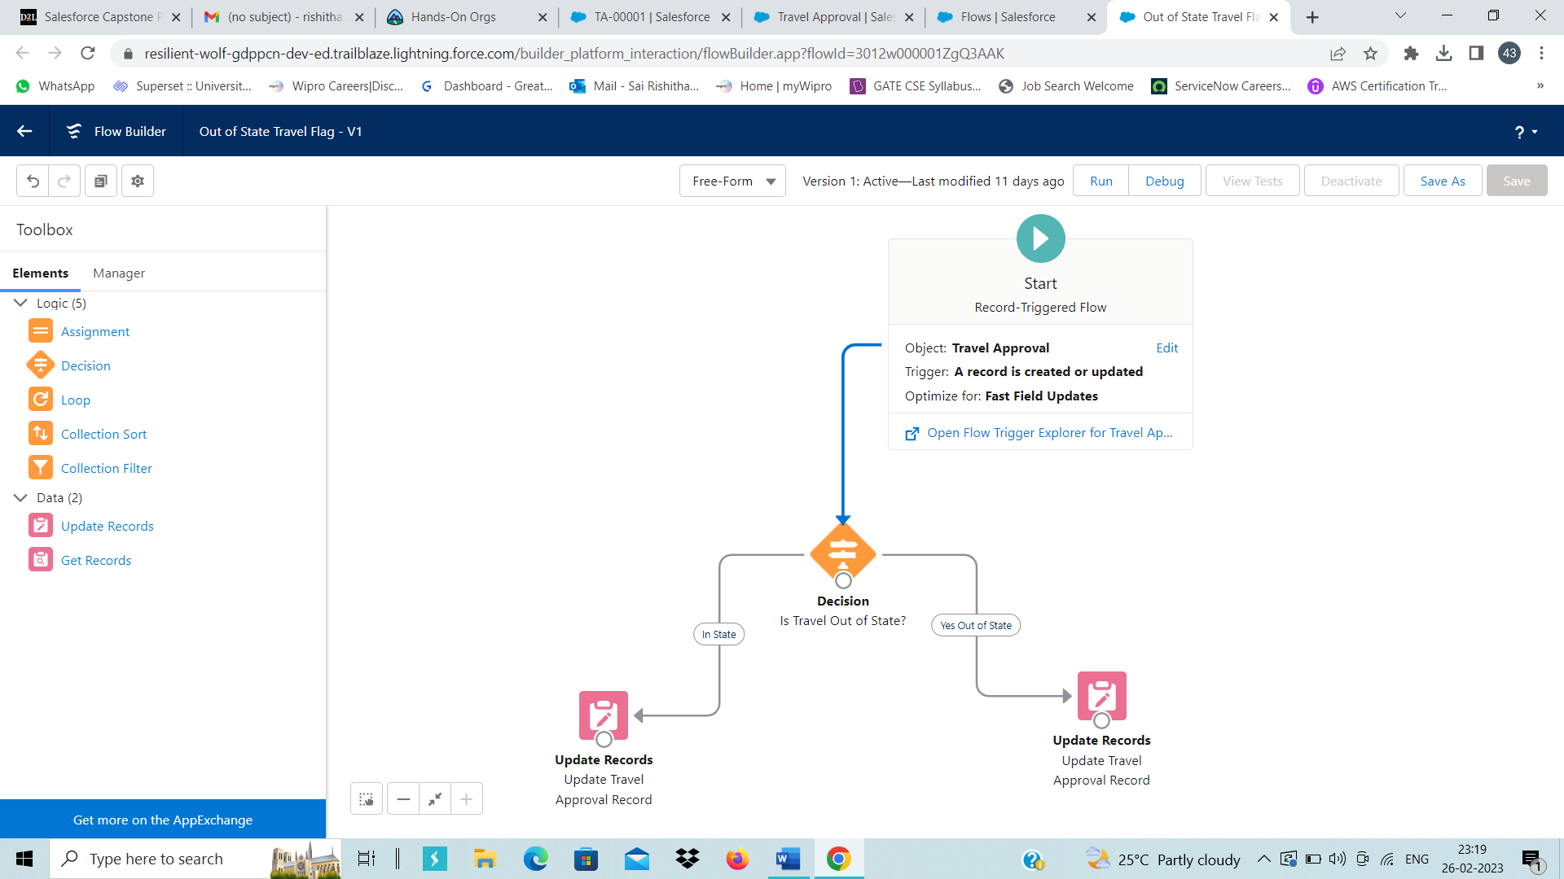
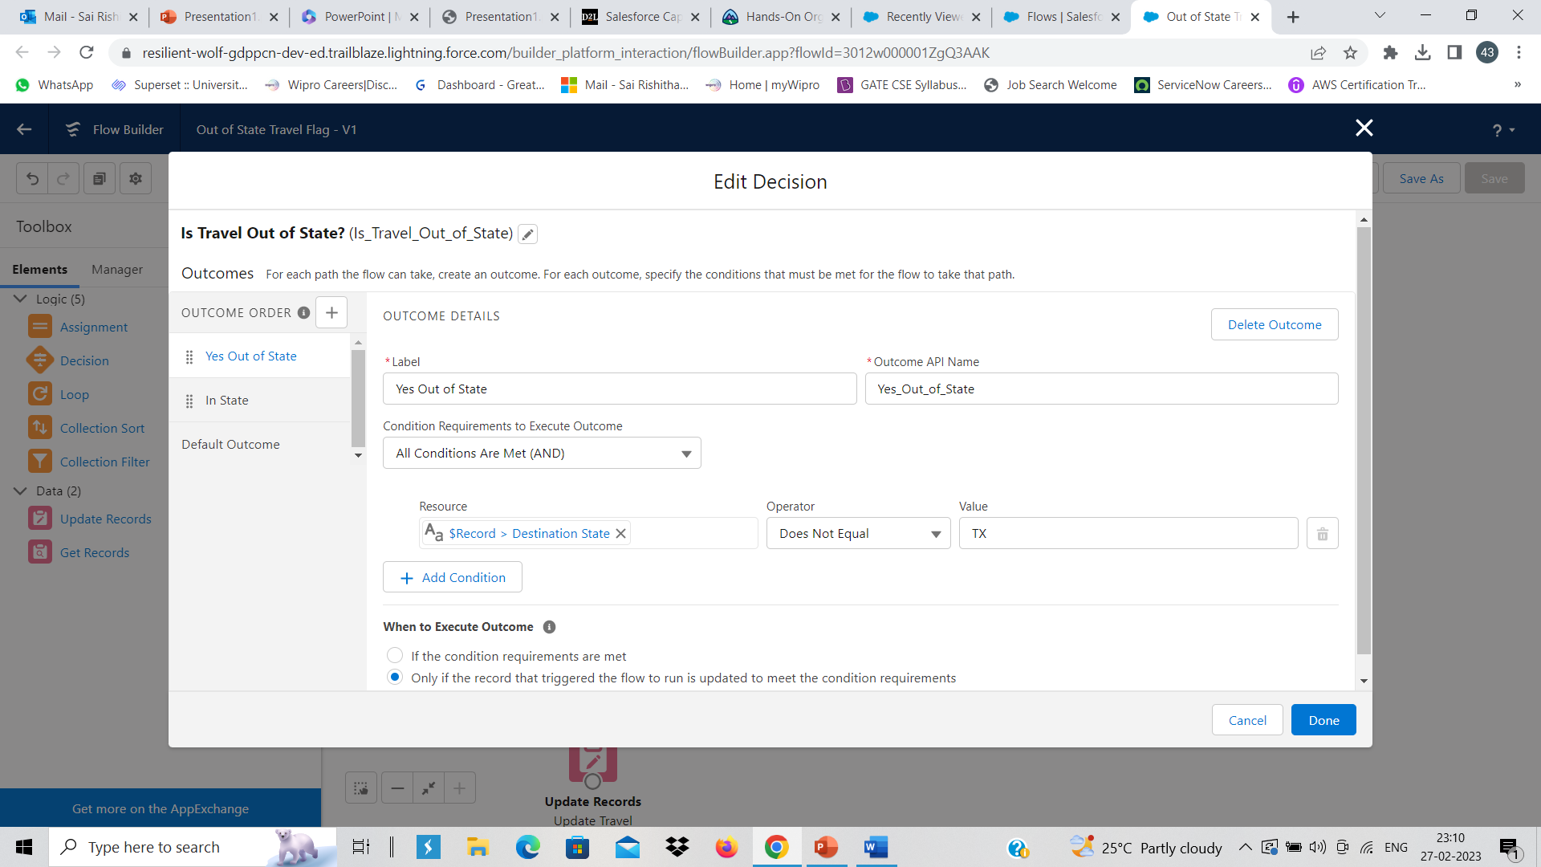
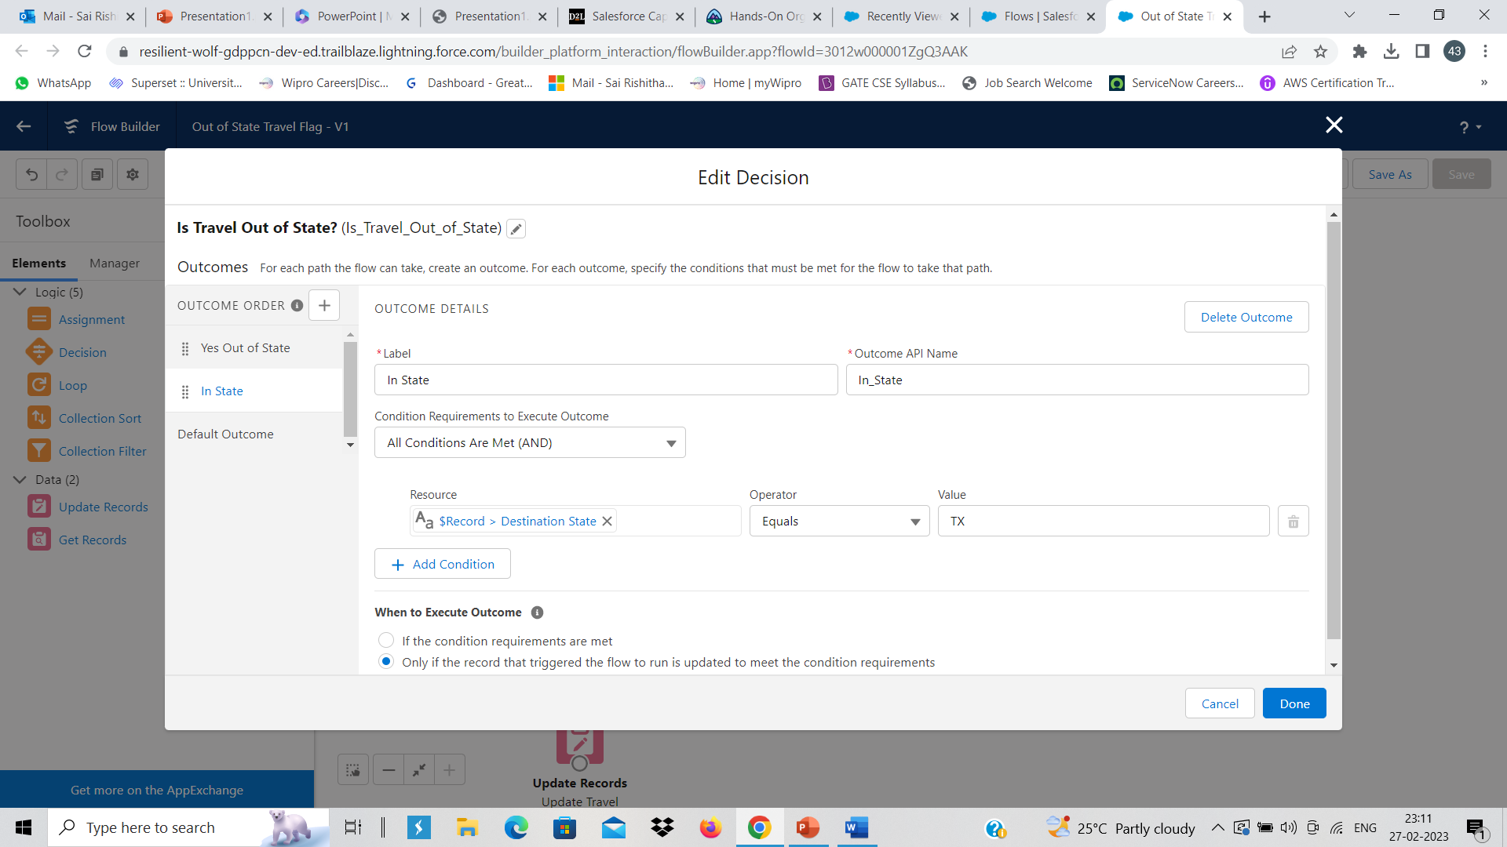
Step-5​ Created a record-triggered flow labelled "Out-of State travel flag"

Slide 17
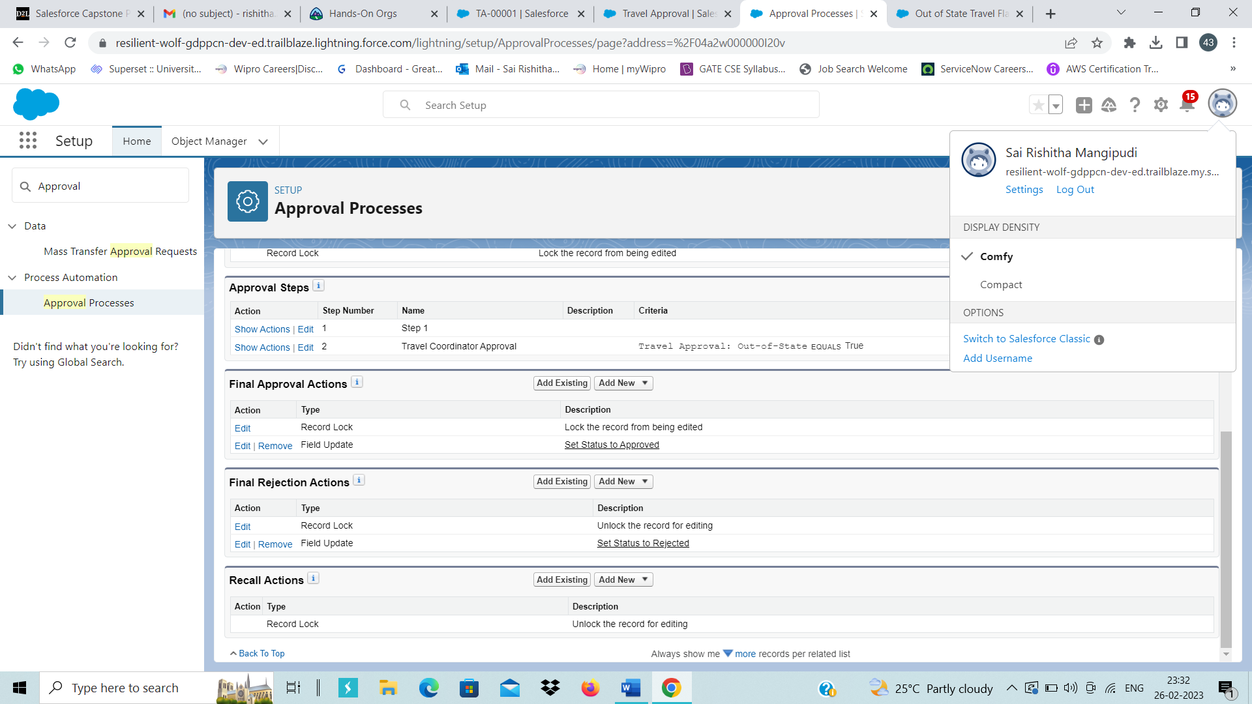
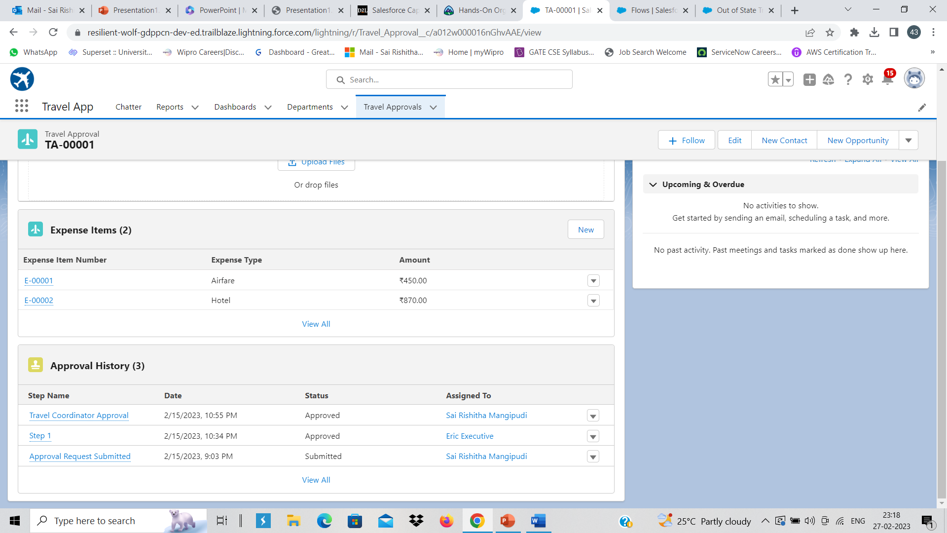
Step-6​ Created an Approval Process named Travel Approval Request

Slide 18
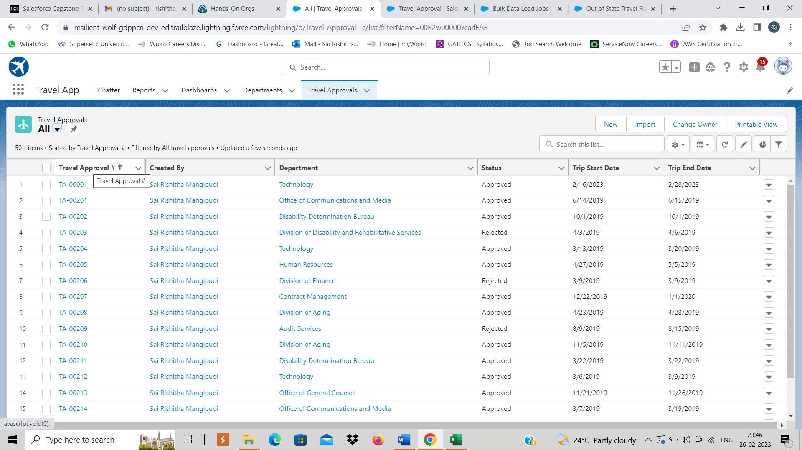
Exercise-2​ Step-1​ Imported Travel Approval records using Data Import wizard

Slide 19
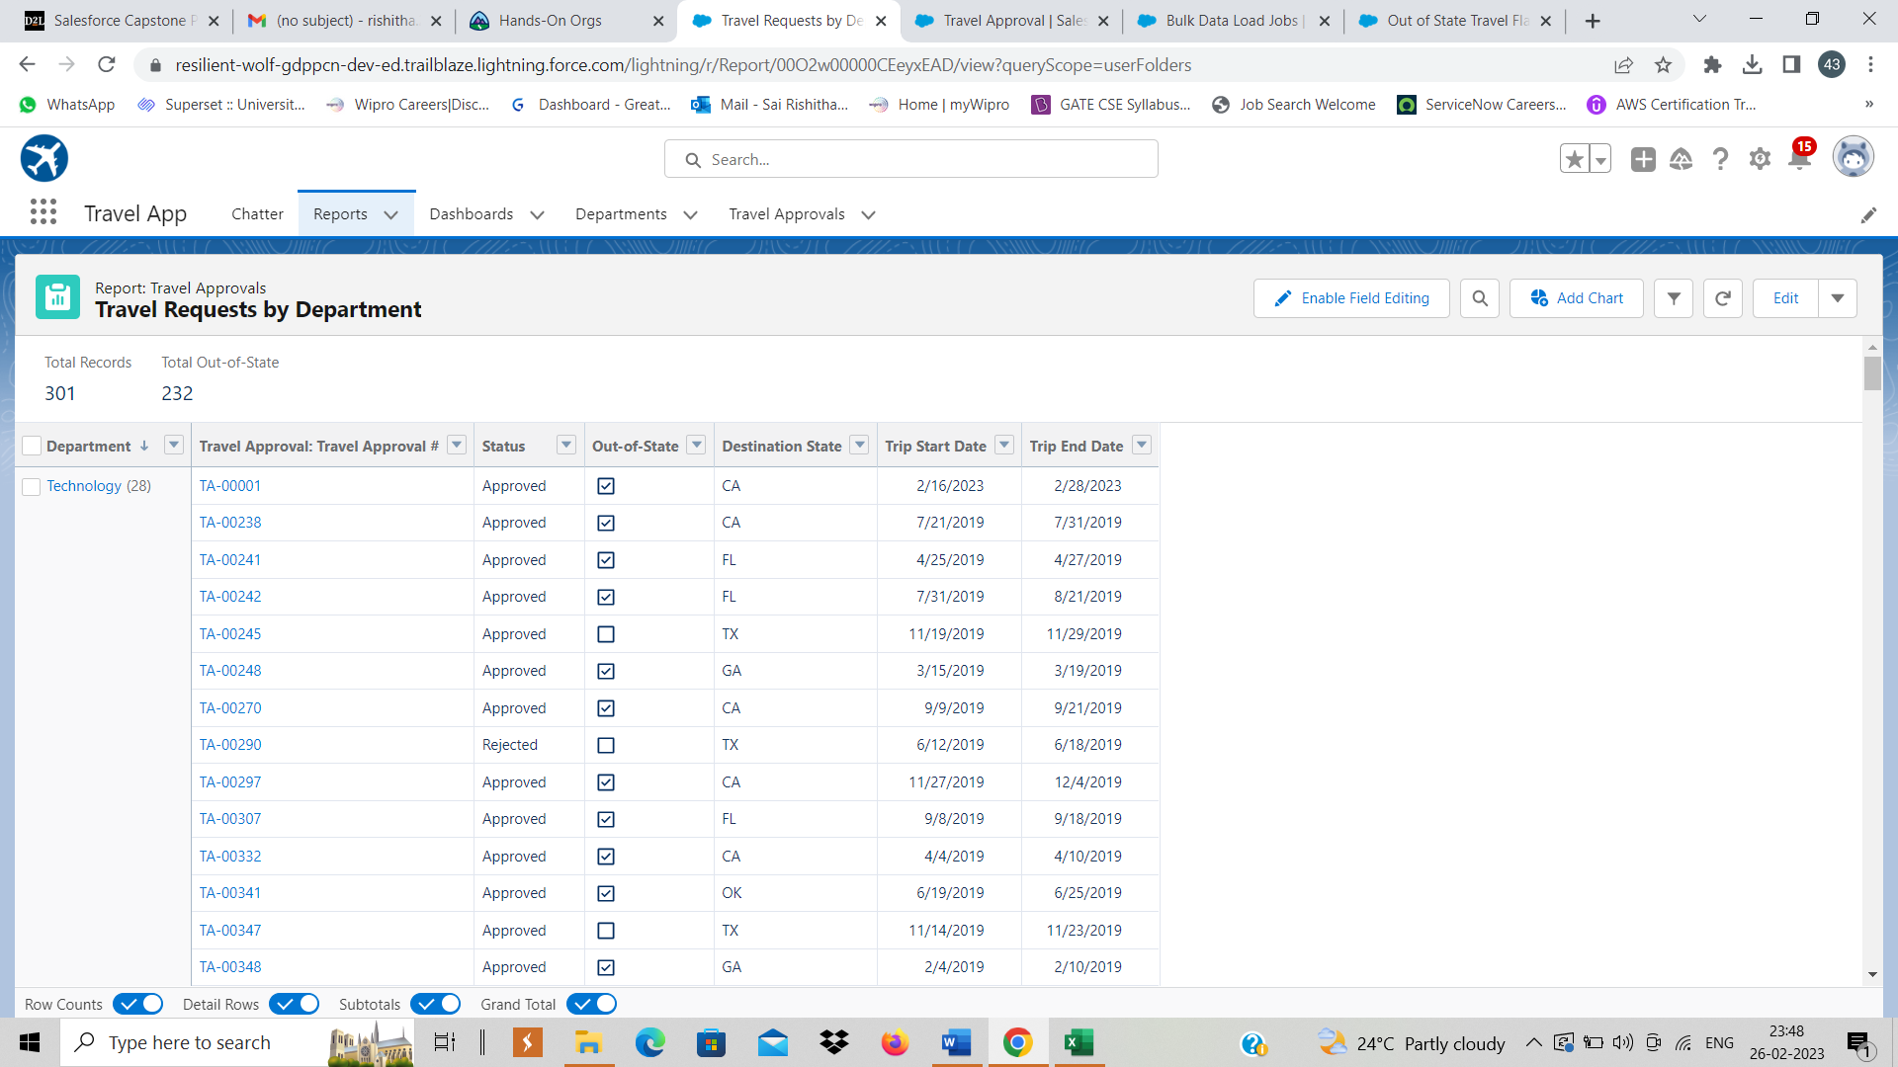
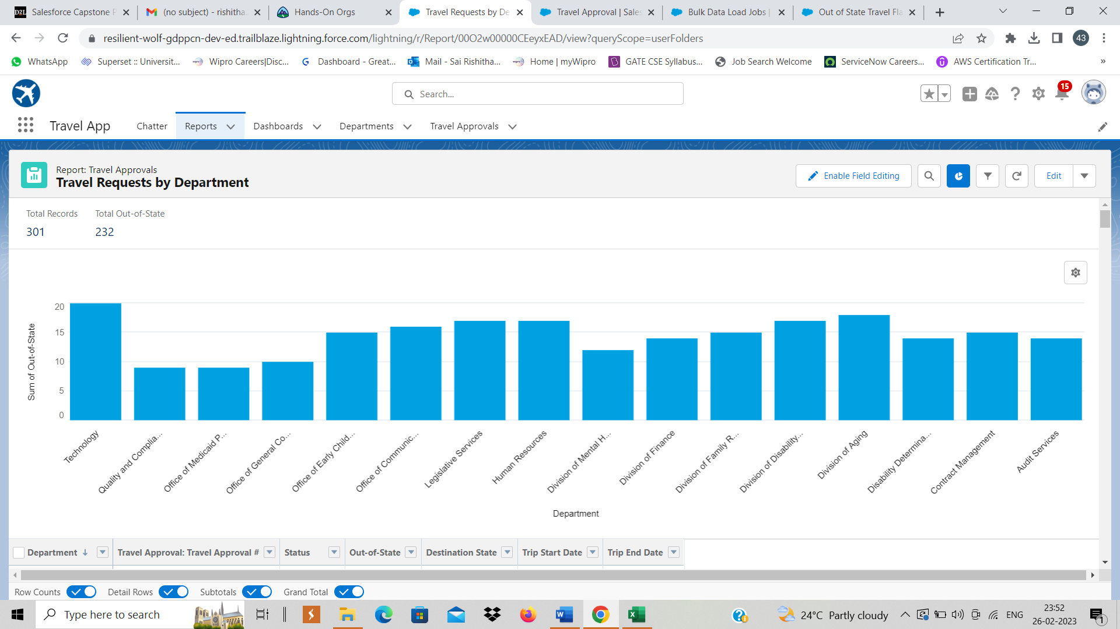
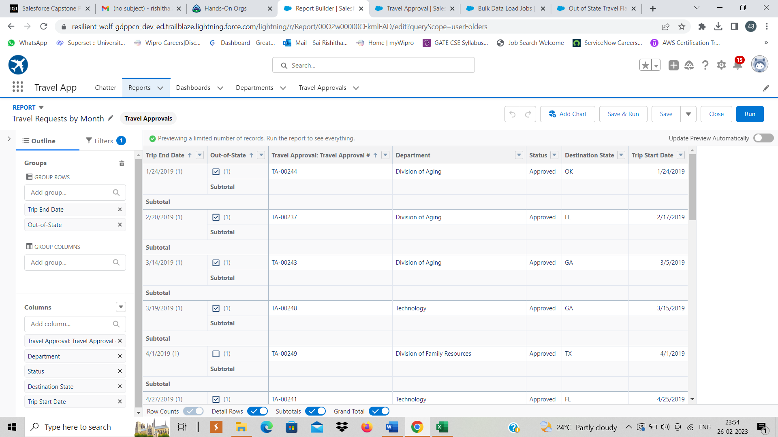
Steps 2&3​ Created Travel Requests by Department and Travel Requests by month Reports

Slide 20
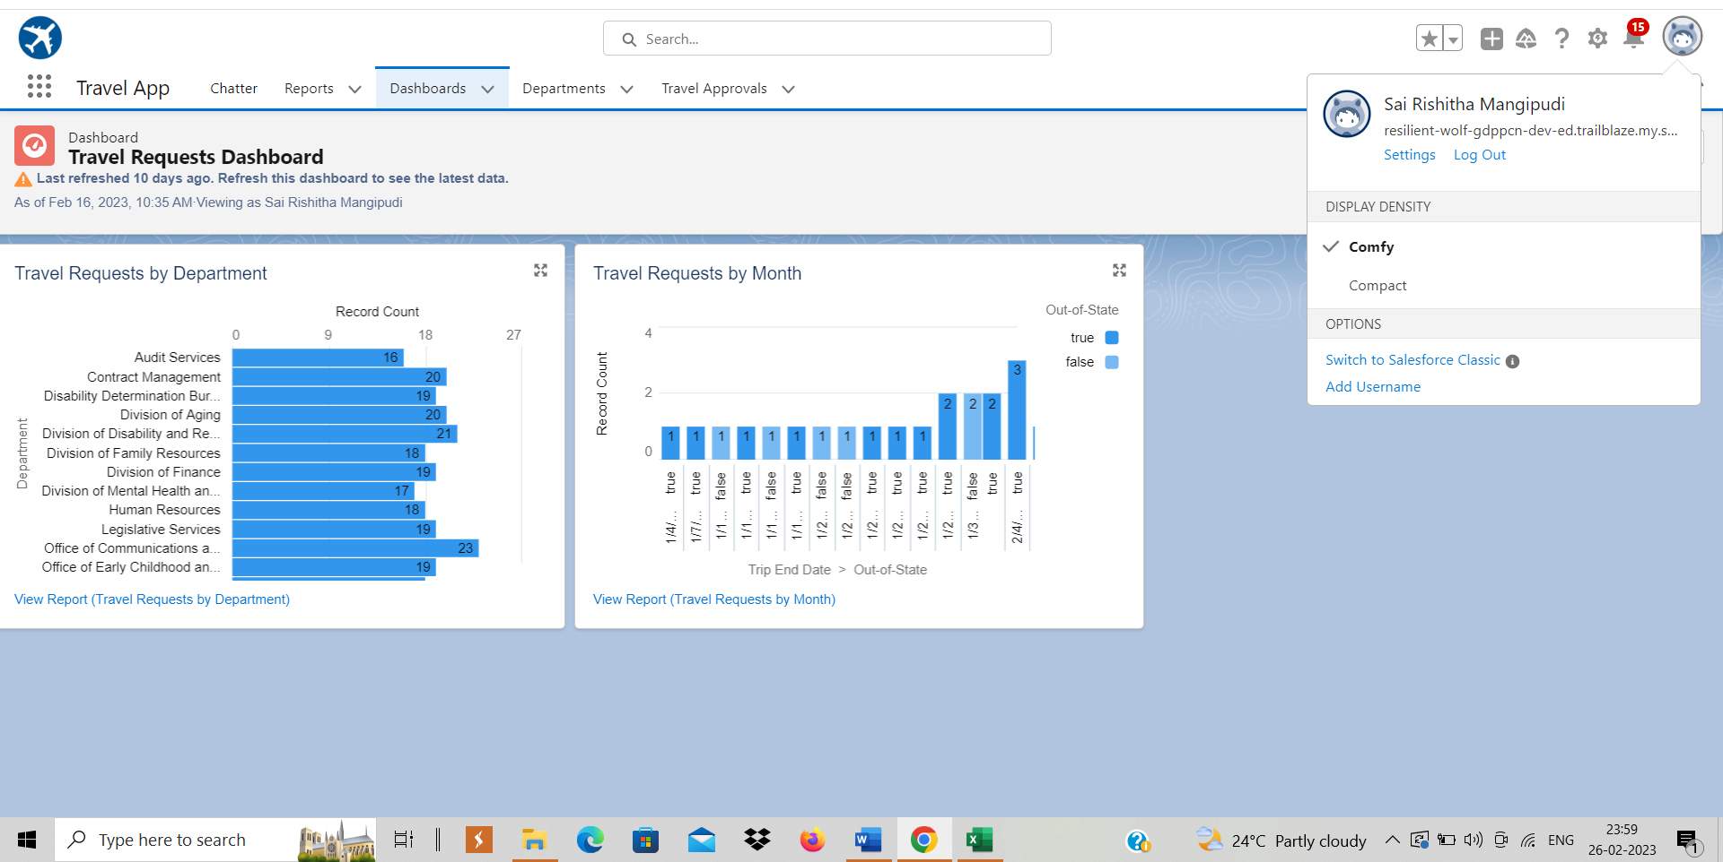
Step-4:​ Created a Travel requests dashboard using the Travel Requests by Department and Travel Requests by Month Reports

Slide 21
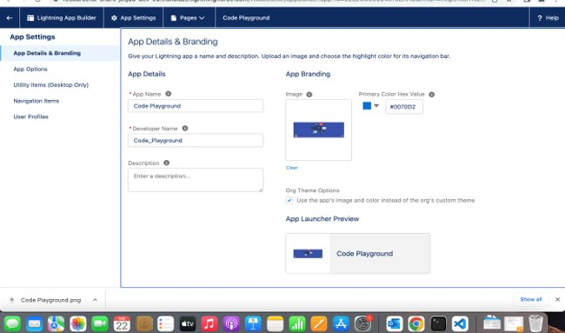
MODULE-3:​
Apex programming skills are demonstrated in terms of Writing and executing codes from Anonymous window, Demonstrating the use of Data types & Variables, Demonstrating the use of Control Flow Statement, Defining relationships between objects and Data Manipulation using DML.Querying the Data base using SOQL, Creating Apex Classes, Objects & Interfaces, Writing Apex Triggers, Test Classes and creating VisualForce Pages.
Exercise-1:​ Created custom lightning App Code Playground​

Slide 22
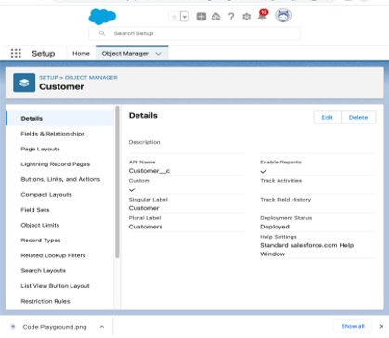
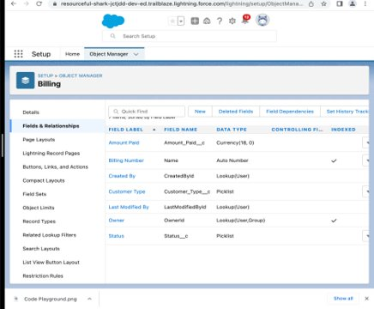
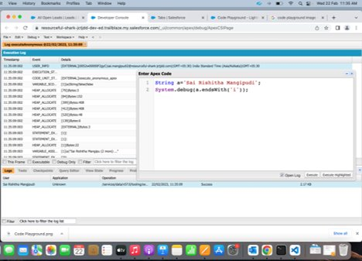
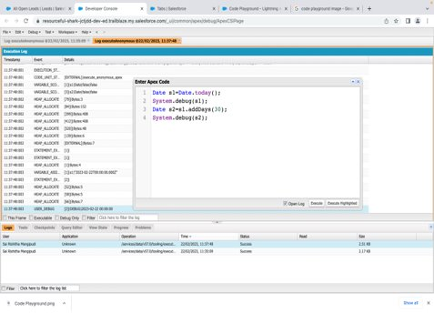
Created custom objects "Customer" and "Billing" with required fields and Tabs
Exercise-2:​ Defined a String Variable & used string method ‘endsWith’ to display the output. Defined 2 Date type variables, used Date method today() & addDays(30) to display the output

Slide 23
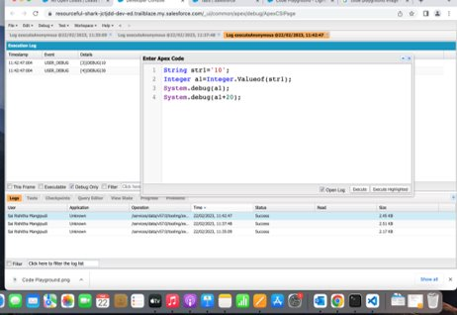
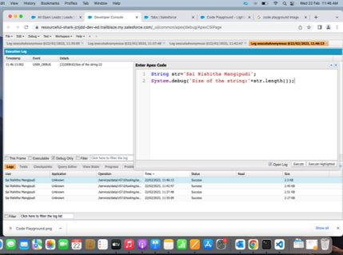
Displayed the output of an Integer variable from string ‘10’ and then added 20 to it. Defined a String Variable & used string method length() to display the output.

Slide 24
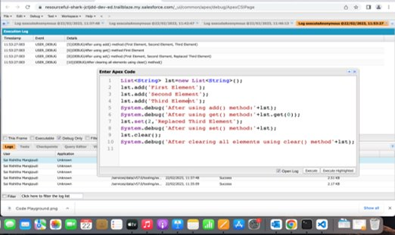
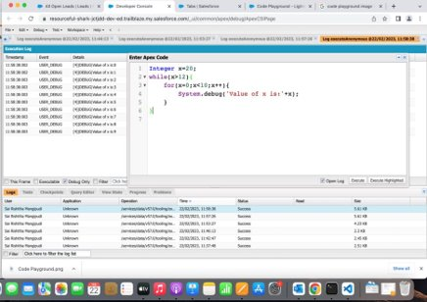
Defined a List of integer and displayed the output using add(), get(), set(), clear(), methods.Executed code to demonstrate the working of while loop to print the values from 0 to 9

Slide 25
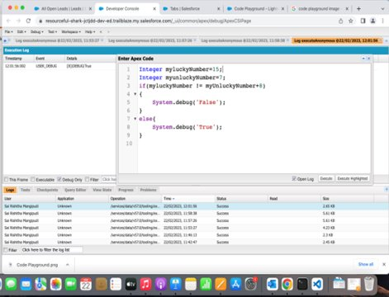
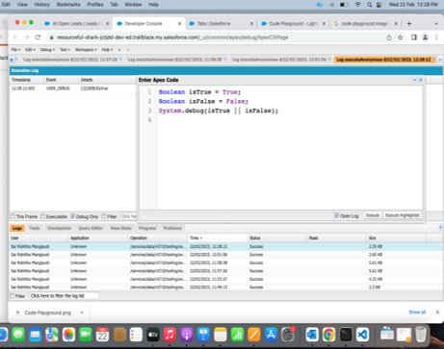
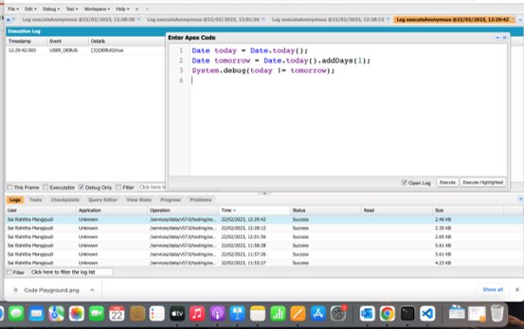
Exercises 3-5:​ Executed the codes to return true or false while using the "NOT" and "OR" operators. Executed the code to check for addDays() Date function

Slide 26
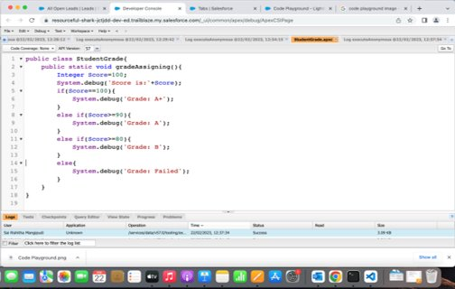
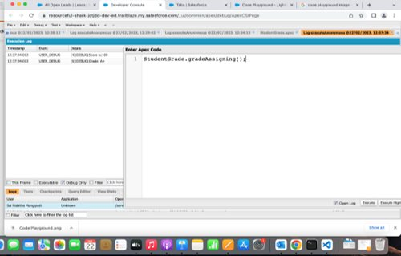
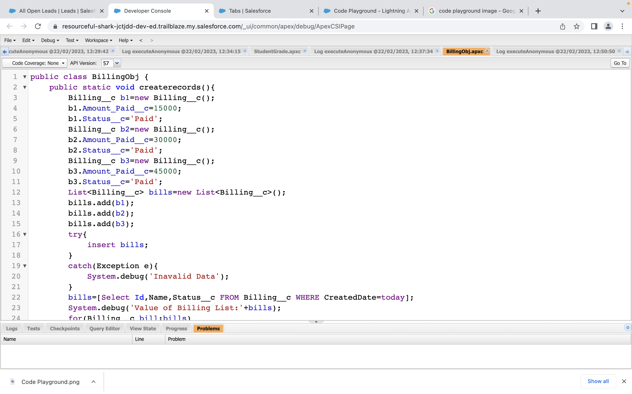
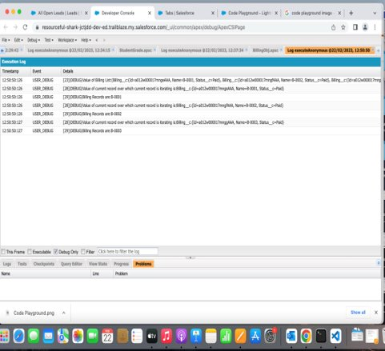
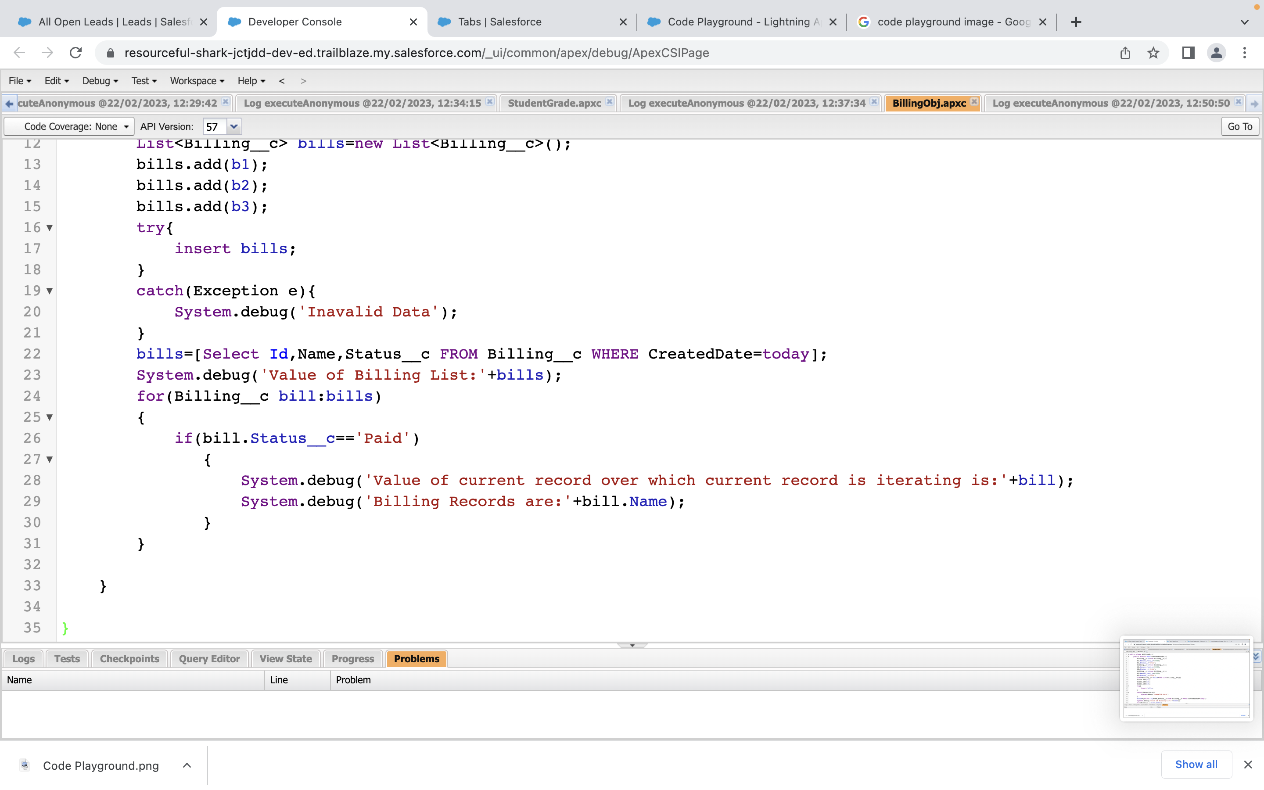
Exercise 6 ​ Executed the program to demo "if-else" to print student grade.
Exercise 7​ Executed the program to demo "Apex for-loop"

Slide 27
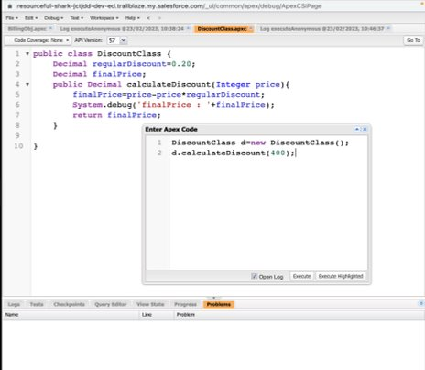



Exercise-8:​ Class to demo the use of Constants in Apex
Exercise-9:​ Demo the use of Interface in Apex

Slide 28


Exercise-10:​ Demo on DML Insert Operation Using Database methods
Exercise-11:​ Executed SOQL queries from Developer Console​

Slide 29



Exercise-12:​ Executed a Trigger named Customer trigger
Exercise-13​ Developed a Test class for Customer Trigger

Slide 30



Exercises 14 & 15:​ Created Apex Trigger Disqualify Test Leads. Created Test class for Disqualify Test Leads Trigger

Slide 31




Exercise-16​ Created a Visualforce page which displays Opportunity fields as output fields
Exercise-17:​ Created a Visualforce page which shows a list of Accounts linked to their record pages

Slide 32


Exercise-18​ Created a Visualforce page that uses a custom controller to display a list of cases with the status of 'New'

Slide 33
References:
Manage sales - Salesforce IN
Salesforce - ADX201 Administrative Essentials for New Admins in Lightning Experience (SFADX201) (qa.com)
Understand the Salesforce Architecture Unit | Salesforce Trailhead

Slide 34
Thank You.
Notes:
how can you solve this problem if you have no single system of truth?

